Slide 1

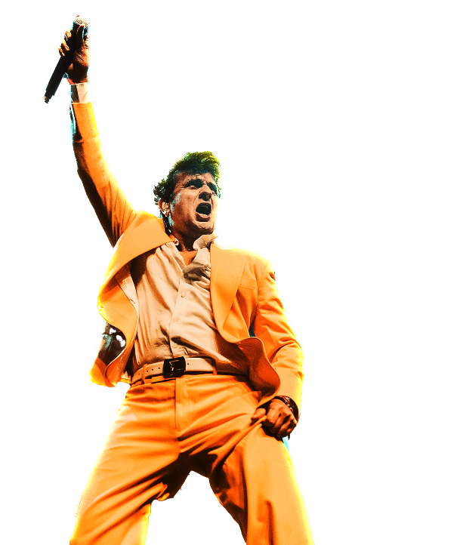

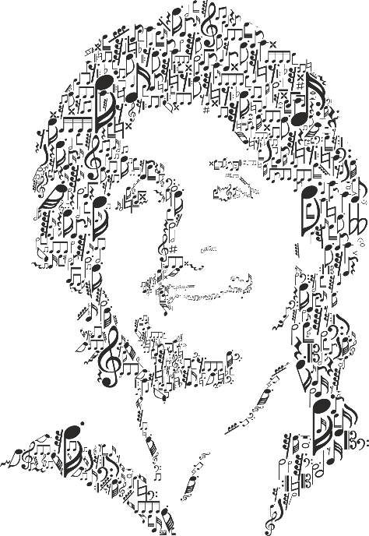






CONCEPTUALISED
& PRODUCED BY
Notes:
One Voice, One World – Sonu Nigam Tour

Slide 2


Sonu Nigam started performing at age 3 — was born for the stage.
Rocked sold-out arenas from Sydney to San Francisco, Dubai to Durban.
ACTIONS SPEAK LOUDER
Recorded over 6,000 songs in 32 languages across his career.
Truly is the voice of generations — from ‘Sandesh Aate Hai’ to ‘Kal Ho Naa Ho’ to ‘Papa Meri Jaan.’
Honored with Padma Shri, National Award, Filmfare, and IIFA — and the list kept growing.
Sonu Nigam’s live concerts blends in nostalgia, power, and emotion — a true musical experience!
#RevolutionTourWithSonu

Slide 3
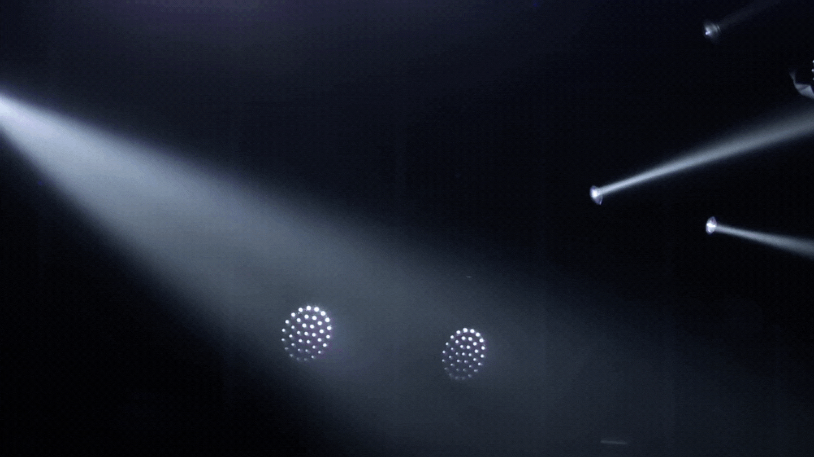

OCT 2026 TO MAR 2027
THE CALENDAR
BENGALURU
NAGPUR
24 October 26
16 January 27
PUNE
LUCKNOW
31 October 26
30 January 27
SURAT
CHANDIGARH
14 November 26
6 February 27
INDORE
JODHPUR
5 December 26
20 February 27
BHOPAL
NAVI MUMBAI
9 January 27
13 March 27
*Subject to change
#RevolutionTourWithSonu

Slide 4

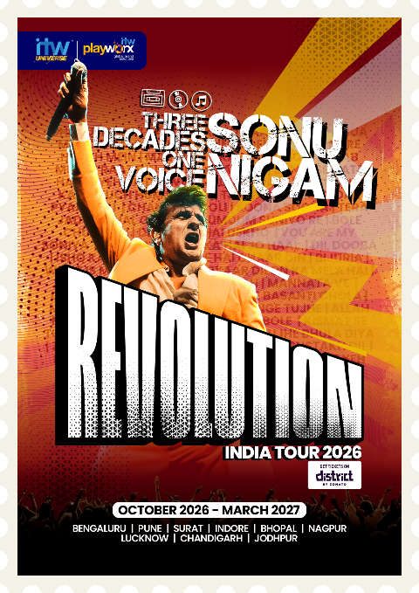
SHOW
HIGHLIGHTS
ACTIONS SPEAK LOUDER
The ICONIC REVOLUTION TOUR: The Sonu Nigam Tour 2026 is more than a concert — it’s a high-energy, tech-powered musical spectacle featuring dancers, immersive visuals, and stunning effects like pyros, lasers, CO2 blasts, Xylo bands, fire shots, drones, sky projections & zipline fireworks.
TOUR POSTER
#RevolutionTourWithSonu

Slide 5
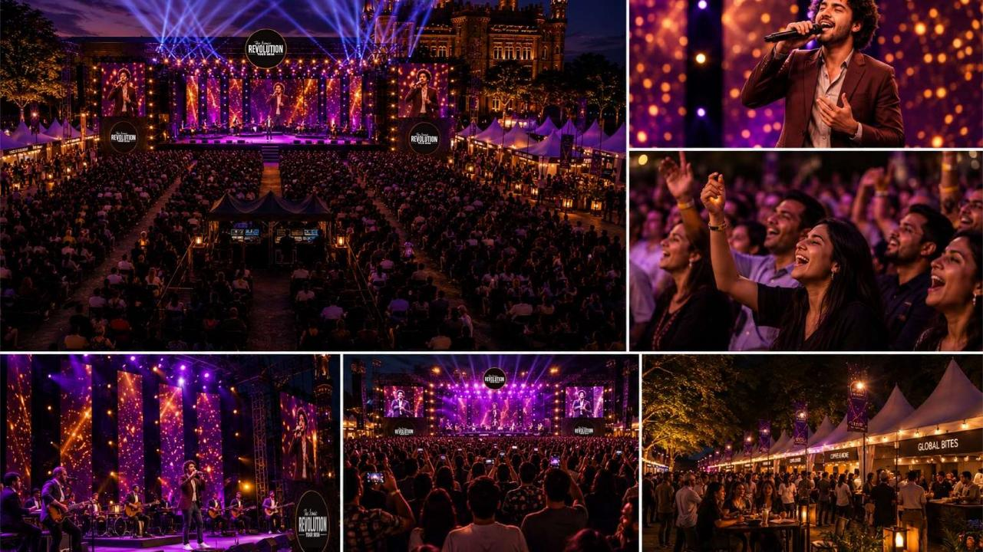
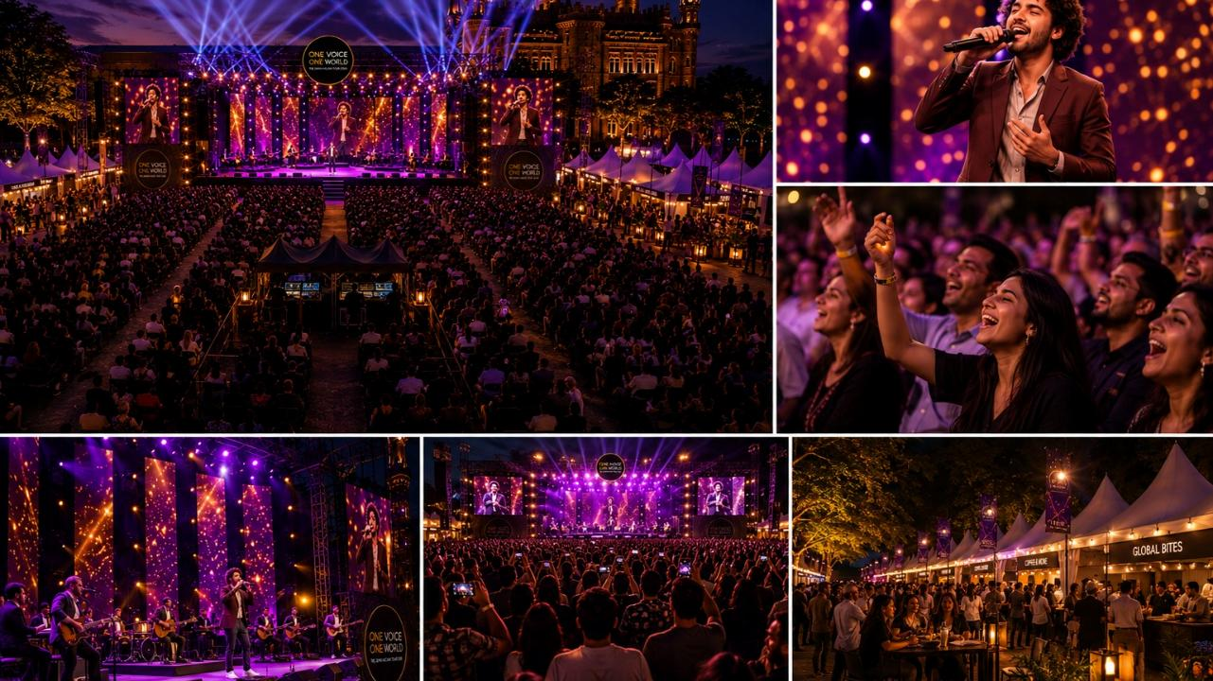

Slide 6
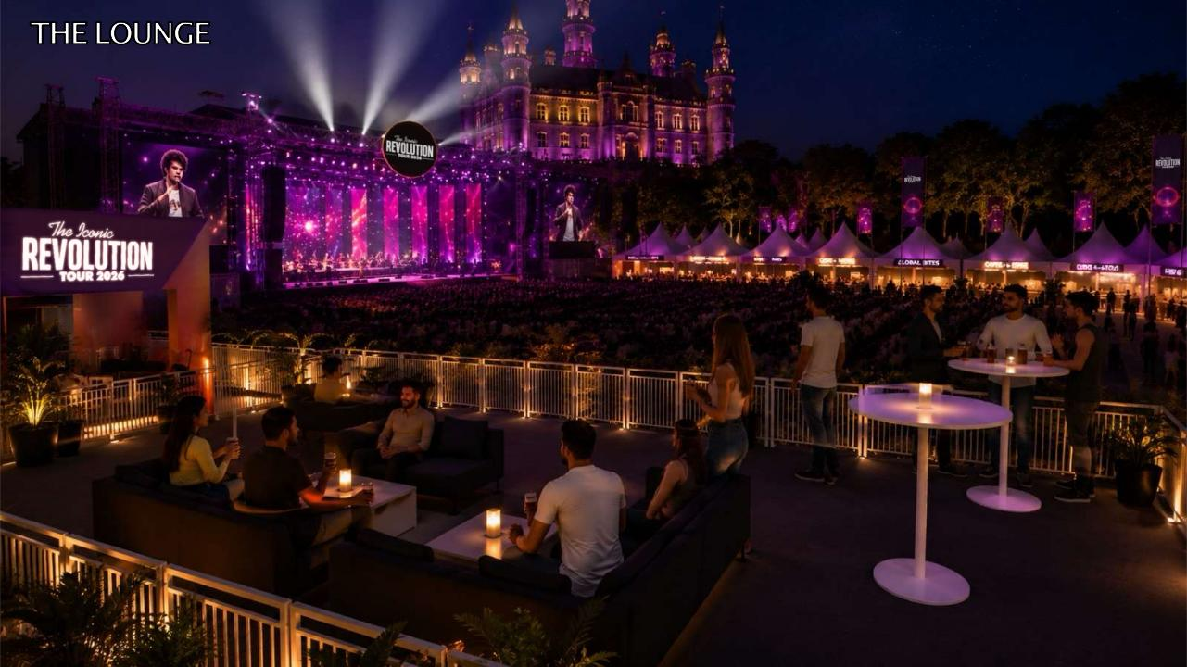
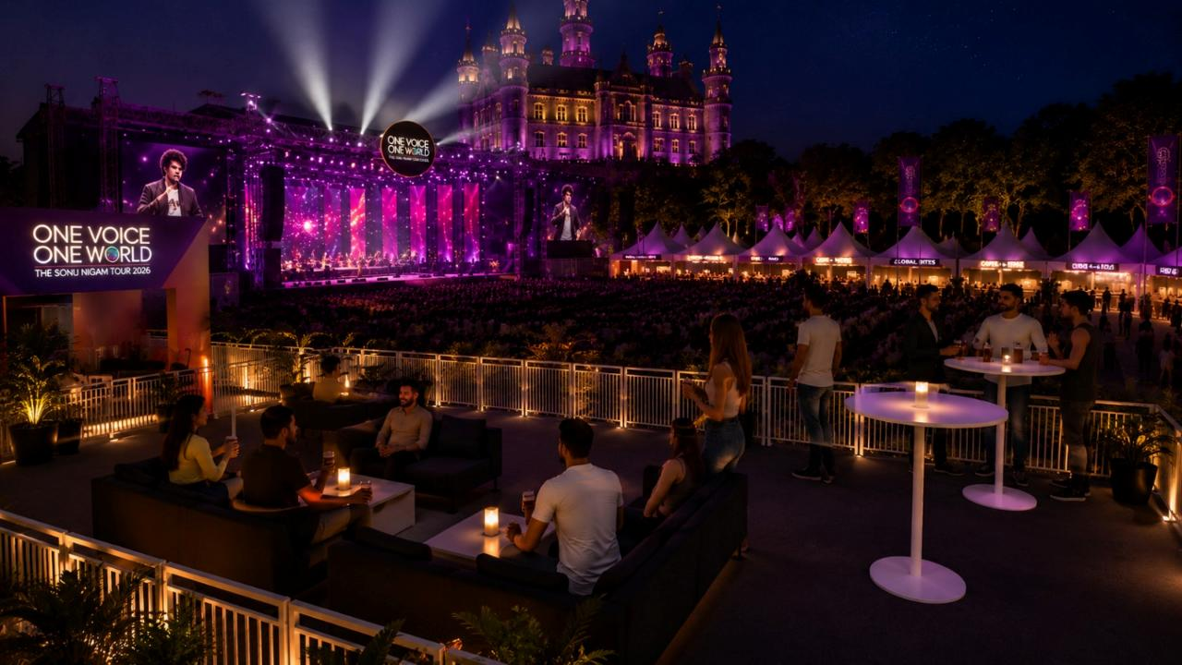
The LOUNGE
THE LOUNGE

Slide 7
PRESENTING
SPONSOR
₹ 5 Cr.
PRESENTS
POWERED BY
POWERED BY
SPONSOR
POWERED BY
SPONSOR
₹ 2.5 Cr.
₹ 2.5 Cr.
IN ASSOCIATION WITH
ASSOCIATE
SPONSOR
ASSOCIATE
SPONSOR
ASSOCIATE
SPONSOR
ASSOCIATE
SPONSOR
₹ 1 Cr.
₹ 1 Cr.
₹ 1 Cr.
₹ 1 Cr.
#RevolutionTourWithSonu

Slide 8
Usage Rights and Logo Presence
Deliverables | Presenting Sponsor | Remarks
Naming rights of the tour | Yes; XYZ presents Sonu Nigam Tour
Part of the integrated unit | Yes; as Presenting sponsor
Category exclusivity | Yes | Category to be mutually decided
Rights to use the event Key visual | Yes | Key visual to be provided by ITW, to be used by the brand as per guidelines provided by the artist and ITW Creative to be approved by ITW
Brand AV | Yes | To be played on screen prior to artist taking over the stage
Brand logo on LED wings | Yes | To be played on screen prior to artist taking over the stage As per sponsor hierarchy
Exclusive branding | Yes | Number of boards as per sponsor hierarchy Production to be done by the sponsor at additional cost
Venue signage | Yes | Placement as per sponsor hierarchy
Venue announcements | Yes
Logo carriage across all event led promotion | Yes | Placement as per sponsor hierarchy

Slide 9
Social Media and Tickets
Deliverables | Presenting Sponsor | Remarks
Welcome post | Yes | To be made by ITW
Social media integration (collab posts) | Yes - 2 nos. per show | Content to be mutually decided and in the context of the event Artist social media access will NOT be provided
Post event bespoke video | Yes - 1 nos. | To be made by ITW Video posting to come out of above collab post count
Tickets | Yes; 10% of the deal value
Contest rights | Yes | Contest mechanism to be mutually agreed upon by ITW and the brand Any tickets for contest gratification purposes to come from brand's complimentary ticket allocation

Slide 10
Exclusive Experiences
Deliverables | Presenting Sponsor | Remarks
Exclusive ticket pre-sale/flash sale window | Yes | Mechanics to be mutually decided in conjunction with the ticketing partner
Brand engagement zone at the venue | Yes | Size and placement to be confirmed basis final layout All production, manpower and costs related to running the kiosk to be borne by the brand
Lounge naming rights | Yes | Lounge production to be undertaken by ITW Any bespoke experiences/engagement to be undertaken at brand's cost
Artist meet and greet | Yes; 2 opportunities | Not more than 5 people per brand
ACTIONS SPEAK LOUDER

Slide 11
ON AIR Deliverables*
4 week Build up to the concert date
16 Promos
3 RJ Mentions
31/10/26 – Pune (RedFM)
05/12/26 – Indore (RedFM)
09/01/27 – Bhopal (RedFM)
30/01/27 – Lucknow (RedFM)
20/02/27 – Jodhpur (RedFM)
13/03/27 – Navi Mumbai (RedFM)
* on air tag Brand Name + Closing tag 7 sec ONLY in above REDFM Markets

Slide 12
National Digital Deliverables
4 Weeks of Digital Promotion Across Red FM’s NATIONAL Social Handles
1 Tour Announcement Reel.
3 Reels Promoting The Hit Music of The Artist.
1 Artist Shoutout Reel.
4 RJ Reels Promoting The Tour.
3 Reels Showcasing The Tour Travelling Across Cities.
PLEASE NOTE
*Presence In ILU (Integrated Logo Unit) For National Title, Presenting & Powered By Partners Only.
*Caption Tagging On Posts For National Title, Presenting & Powered By Partners Only.

Slide 13
Regional Digital Deliverables
2 Weeks of Digital Promotion Per City (*Only RED FM Markets) On Red FM’s Regional Social Media Handles + Amplification On RJ Social Handles
PRE-PROMOTION
1 Announcement Post
1 Video Promo
2 Reels Promoting The Artist’s Music
1 Artist Shoutout Reel
2 RJ Reels Promoting The Event
3 Countdown Reels
Social Media Cover Change For 1 Week
EVENT DAY PROMOTION
2 Photo Carousels
2 Artist Performance Reels
5-10 IG Stories
PLEASE NOTE
*Each Post To Be Shared As An IG Story By 1 RJ Per Market Tagging Their Local Sponsors.
*Presence In ILU (Integrated Logo Unit) For National Title, Presenting & Powered By Partners Only.
*Caption Tagging On Posts For National Title, Presenting & Powered By Partners Only.
*All Partner Logos To Feature Collectively On Social Media Covers Only.

Slide 14
Marketing Deliverables
Deliverables | Cities | Remarks
Cinema Branding | Bangalore, Chandigarh, Surat, Indore, Bhopal, Mumbai, Pune & Nagpur | 2 Weeks 20 seconds audio slide in cinemas
Newspaper Ad | Navi Mumbai, Pune, Jodhpur, Indore, Bhopal & Lucknow | 2 Print Ads in Each City (60 CC)
Trade Mailers & PR | All Cities | Interviews, Listicles, Articles, and Press Coverages
OOH & DOOH – Café’s & Cinema Lobby Screens | Café – 3 Cities : Bangalore , Chandigarh & Pune Cinema Lobby Screens – Bangalore, Chandigarh, Indore, Lucknow, Mumbai & Pune OOH - Jodhpur | 10 Secs Spot across all Screens

Slide 15
CONCEPTUALISED
& PRODUCED BY
Notes:
One Voice, One World – Sonu Nigam Tour

